Slide 2
fast facts.
Vision | We envision the day when everyone can access safe water and experience the dignity of sanitation.
Mission | Water.org challenges the traditional approach. Our goals are to draw attention to the world’s number one health problem, unsafe and inadequate water supplies, and to raise funds to help fight this immense problem – one community at a time.
Founded | 1990 as a 501(c)3 nonprofit organization
FY11 | $7MM/yr operating budget
Global Presence | Headquartered in Kansas City, MO with presence in Washington, San Francisco, Nairobi, and Tamil Nadu, India
Core Focus | Demonstrate market-based solutions through WaterCredit, other WASH finance models and improve technology Strategically segment the subsidy market to drive limited philanthropic resources towards the “ultra poor” Increase sector effectiveness, sustainability, and commercial capital investments Raise global awareness for the global water and sanitation crisis

Slide 3
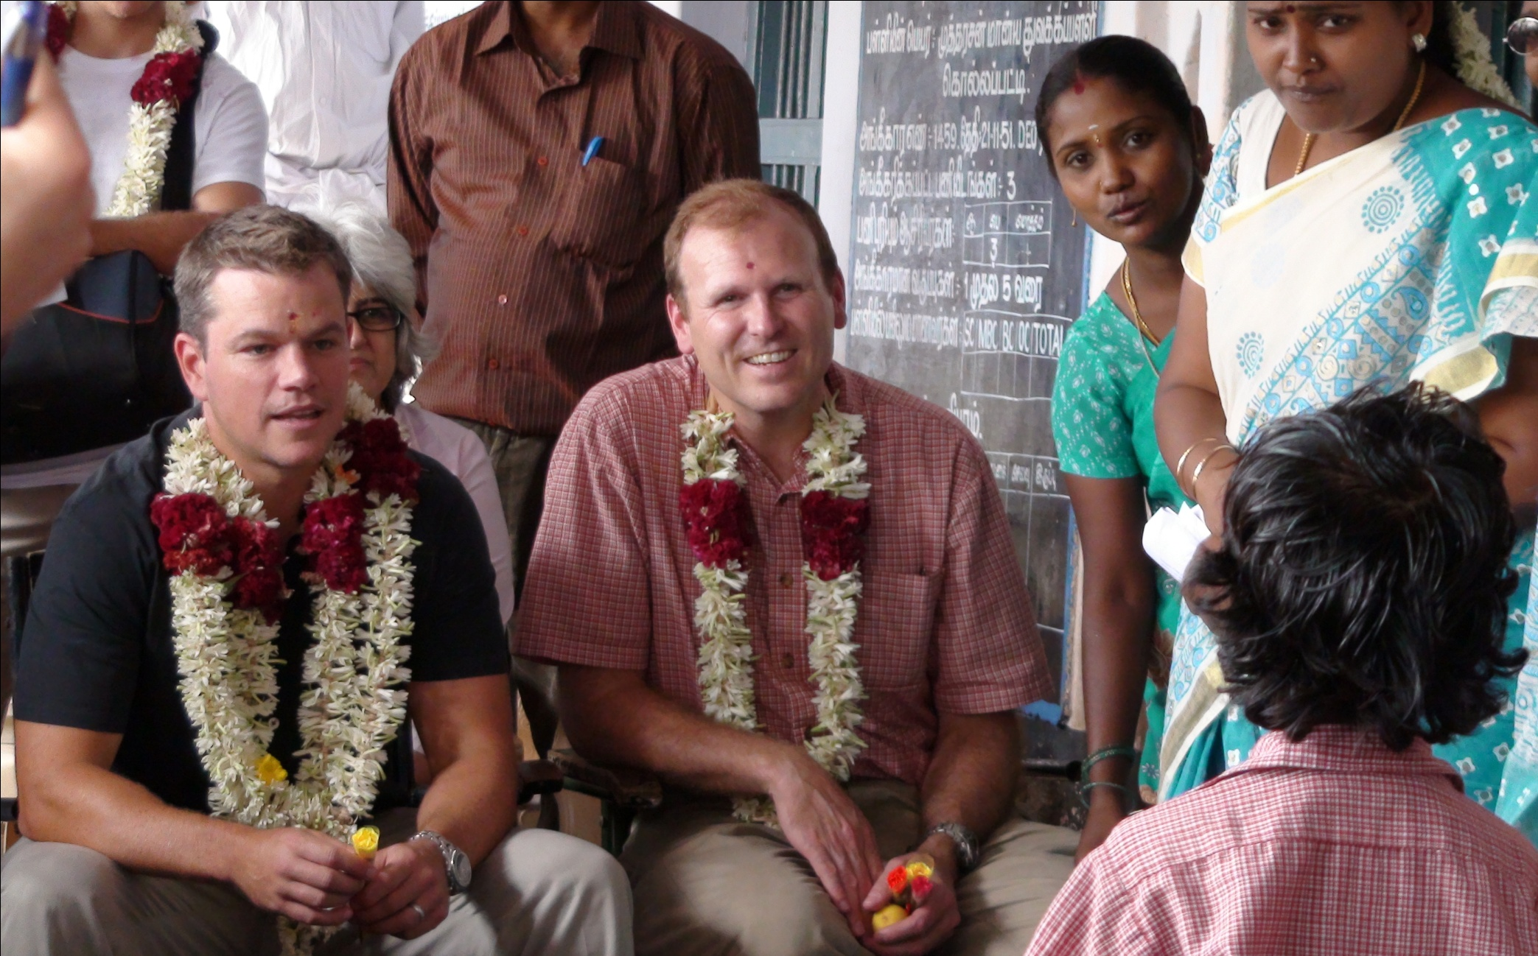

Slide 4
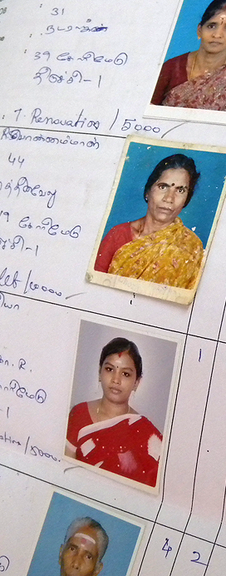
WaterCredit to date.
Leveraging microfinance as a distribution channel and a platform for overcoming market failures
Geographic focus aligned with microfinance sector maturity
Serving the microfinance market—clients/users at the BOP
14 MFI partners in Kenya, Uganda, Bangladesh, and India
Expansion plans for Peru, Ghana, Indonesia, and Cambodia
$1.6MM in philanthropic capital has leveraged over $5MM in private, commercial capital
Represents 50% of the Water.org programmatic portfolio
More than 160,000 people served; on track to serve 1MM by 2014

Slide 5
